Slide 1
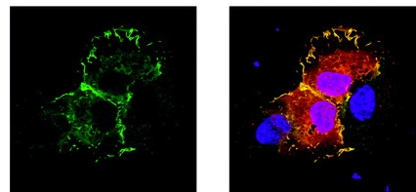
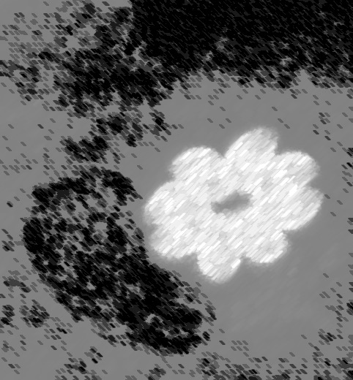
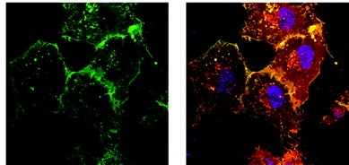
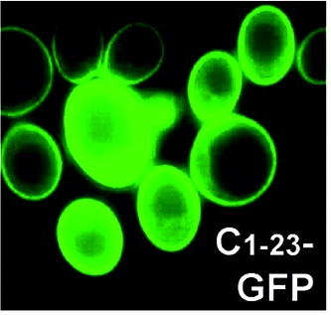
CUS
PROGRAMMES DOCTORAUX
Forum doctoral training infection, Immunity and Cancer
Geneva June 24th 2016, Fondation Louis Jeantet
Organizers : Dominique Soldati-Favre & Dominique Garcin
9.00-9.30 Dr. Jean-Claude Martinou. Sciences III Geneva. Cell metabolism in cancer and
brain function: role of the mitochondrial pyruvate carrier
9.30-10.00 Dr. Berend Snijder. CeMM, Vienna. Image-based screening in blood for
immunomodulatory drugs and personalized patient therapies
10h00-10h30 Students talks
10h30-11h00 Coffee break
11.05-11.35 Dr. Lukas Flatz. CHUV, Lausanne. Vaccination against self- and neoantigens
in melanoma using viral vectors.
11.35-12.05 Dr. Daniela Finke – UKBB, Basel. Developmental Immunology. How do
innate lymphoid cells regulate adaptive immunity?
12h05-12h35 Students talks
12h35-13h55 Lunch
14.00-14.30 Dr Agathe Subtil. Intitut Pasteur, Paris. Tricks for Treats: How Chlamydia
trachomatis hijacks energy stores from its host
14.30-15.00 Dr. Gisou van der Goot. EPFL, Lausanne. The beauty of the aerolysin
pore.
15h00-15h30 Students talks
15h30-16h00 Coffee break
16.00-16.30 Dr. Mathieu Brochet. Faculty of Medicine, Geneva. Making life changing
decisions in 15 seconds, calcium signaling in malaria parasites
16h30-17h00 Students talks
17.00-17.45 Dr Tim Wells, Medicines for Malaria Venture. Discovering and developing
new medicines for malaria.
17.45-19.00 GET TOGETHER APERO

